Slide 1





DAY-1
Python Basics, part 1

Slide 2



Instructor
From: Prodi Teknik Elektro, Institut Teknologi Bandung
Social Media:
Cynthia Evani
@cynthiaevani
Certification:
Google IT Automation with Python
Google Tensorflow Developer
AWS Certified Cloud Practitioner
Experience:
Machine Learning Student, Bangkit Academy (2021)
Machine Learning Engineer, PT Nomura Research Institute Indonesia (2021 - )
Cynthia Evani
DKI Jakarta

Slide 3

What is Python?
High level programming language
Object-oriented approach (OOP)
Interpreted, instead of pre-compiled
One of the most popular programming languages
Notes:
OOP: class (data types defined by user), object (instance of class), method (function that describes object behavior), attributes (state of an object/class)

Slide 4




Why Python?
Open source & community development
Easy to learn, write, & read
Dynamically typed language
Extensive library support & third party modules

Slide 5
System Setup

Slide 6
Python versions
 | Python 2.x | Python 3.x
Release | 2000 | 2008
Function print | print “Hello” | print(“Hello”)
Division of integers | Returns integer | Returns float
Syntax | More difficult | Simpler and easier to understand
Compatibility | Not compatible with Python 3.x | Can be ported to Python 2.x but unreliable
Library | Some older libraries still use Python 2.x | Used by most libraries

Slide 7
Which one to choose?
Python 3.x
(unless there is a specific reason to use Python 2.x, like when your project uses a library built in Python 2.x)
*\(‘-’)/*

Slide 8
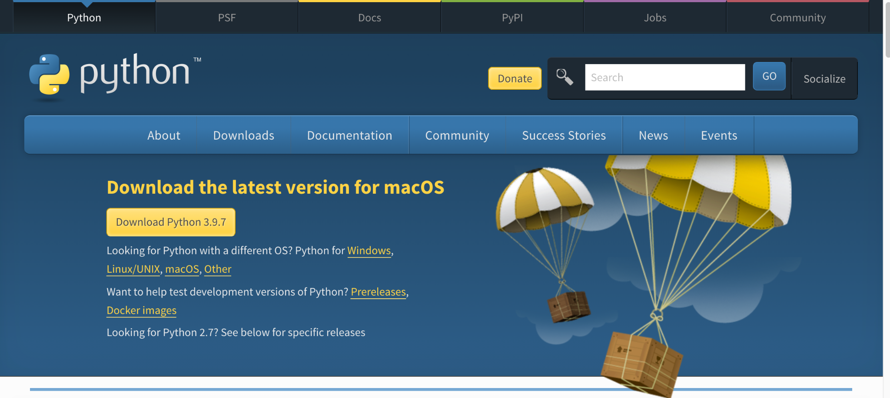
Installing Python on Local (optional)
https://www.python.org/downloads/

Slide 9
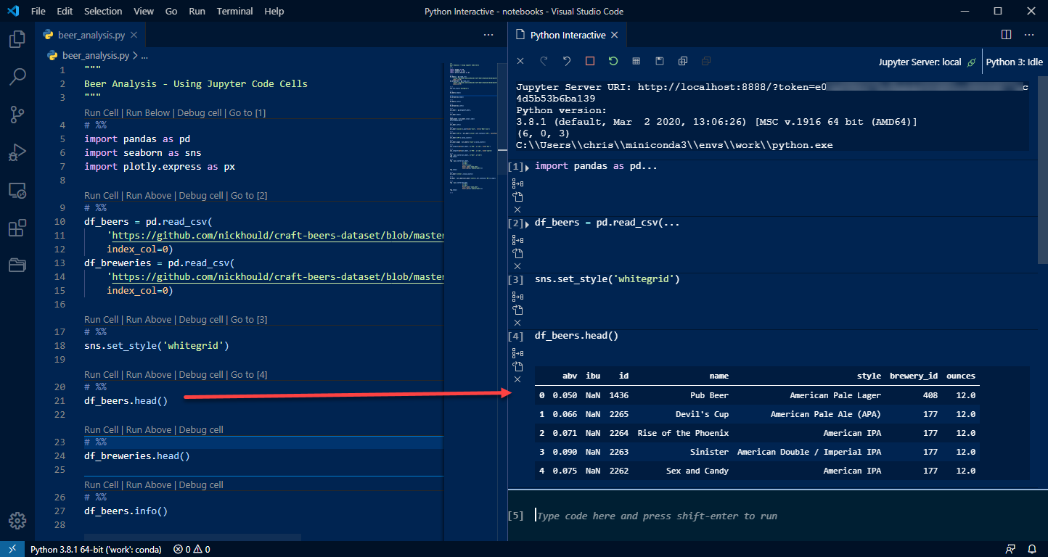
Workflow: Script vs Notebook
script
notebook
Source: https://pbpython.com/notebook-alternative.html

Slide 10
Workflow: Script vs Notebook
Script
Extension: .py
Runs top-to-bottom, single execution
Can be created using any text editor (Atom, Sublime Text, etc.) or PyCharm
Better for production or large scale projects
Notebook
Extension: .ipynb
Interactive, executes cell-by-cell
Generally created using Jupyter Notebook or Google Colab
Better for visualization and debugging
In this class, we will use notebooks.

Slide 11


What do you need?
OR
Jupyter Notebook
Installation: https://jupyter.org/install
Uses local resources
Less recommended unless you already have it set up on your computer
Google Colab
Access: https://colab.research.google.com/
Uses Google’s resources
Recommended, less complicated to setup

Slide 12
Variable & Data Types

Slide 13
Variable
noun
Containers for storing data values

Slide 14
Variable Best Practices (Python)
Follow PEP 8 Guide! (https://www.python.org/dev/peps/pep-0008/)
Should be lowercase, with words separated by underscores as necessary to improve readability.
Avoid name clashes.
Constants are usually defined on a module level and written in all capital letters with underscores separating words.
Variable names are case sensitive, consisting of letters, numbers, and underscores.

Slide 15


Examples
student_name = “Bambang”
stmkg_id_number = “20210020”
gov_id_number = “316500101000”
grade_exam_1 = 80
all_grades = [80, 75, 90]
PI = 3.14
EULER = 2.7818
sekolahtinggimeteorologiklimatologidangeofisika_id_number = “20210020”
x = [80, 75, 90]

Slide 16
Quick Question
studentName = “Bambang”
Is this variable name allowed?

Slide 17
Data Types
Text Type: str
Example:
x = “Hello World!”
Numeric Type: int
Example:
x = 5
Numeric Type: float
Example:
x = 5.0
Numeric Type: complex
Example:
x = 1j

Slide 18
Data Types
Sequence Type: list
Example:
x = [“red”,”blue”,”green”]
Sequence Type: tuple
Example:
x = (“red”,”blue”,”green”)
Sequence Type: range
Example:
x = range(6)
Set Type: set
Example:
x = {“red”,”blue”,”green”}
Set Type: frozenset
Example:
x = frozenset({“red”,”blue”,”green”})

Slide 19
Data Types
Mapping Type: dict
Example:
x = {“name”: “John”, “age”: 21}
Boolean Type: bool
Example:
x = True
Binary Type: bytes
Example:
x = b”Hello”
Binary Type: bytearray
Example:
x = bytearray(5)
Binary Type: memoryview
Example:
x = memoryview(bytes(5))

Slide 20
Variable & Data Types
In Python, there’s no need to declare variables. Rather, we directly assign values to variables.
We can check the data type as follows.

Slide 21
Working with Strings

Slide 22
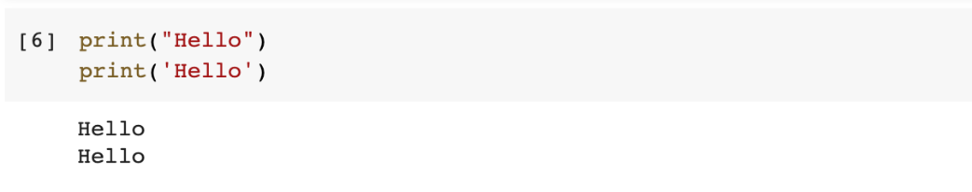
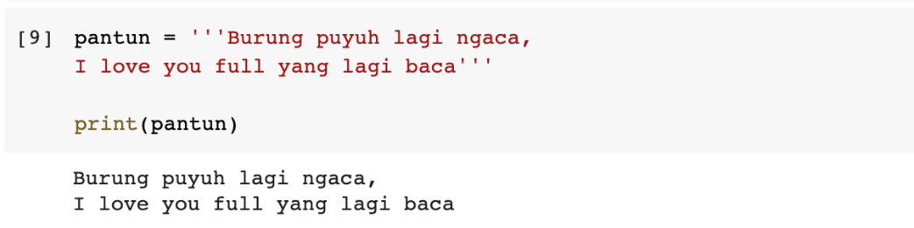
Python Strings
“ vs ‘
Multiline strings

Slide 23
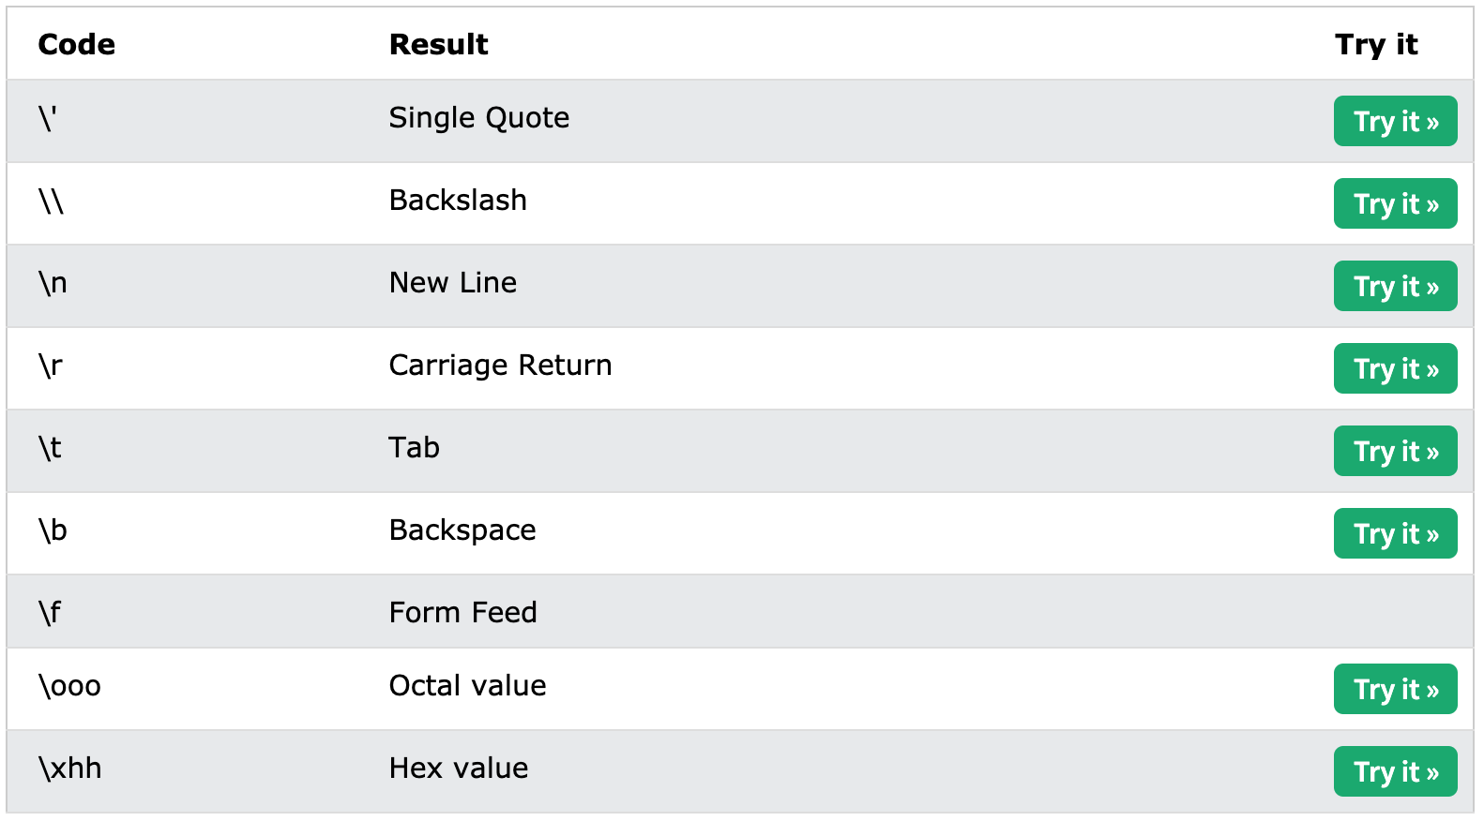
Python Strings
Escape characters

Slide 24
Python Strings
String as array of characters
Length of string

Slide 25
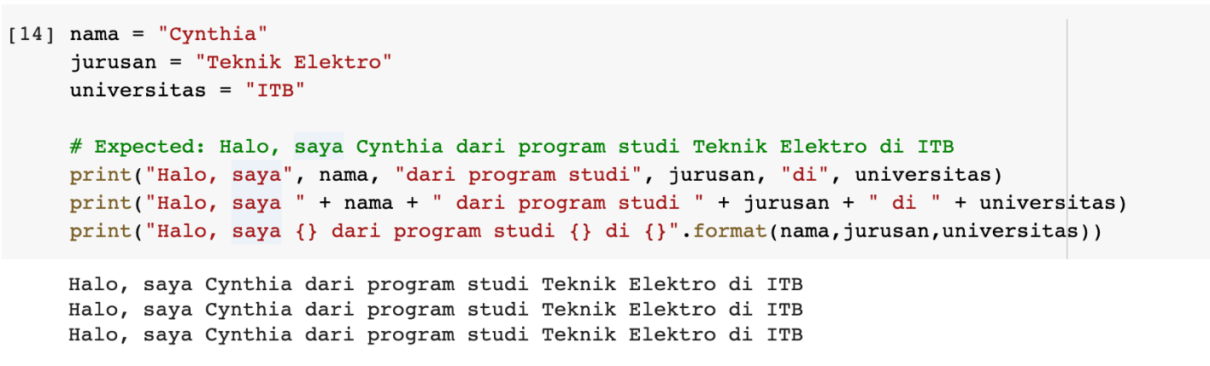
Python Strings
String formatting

Slide 26
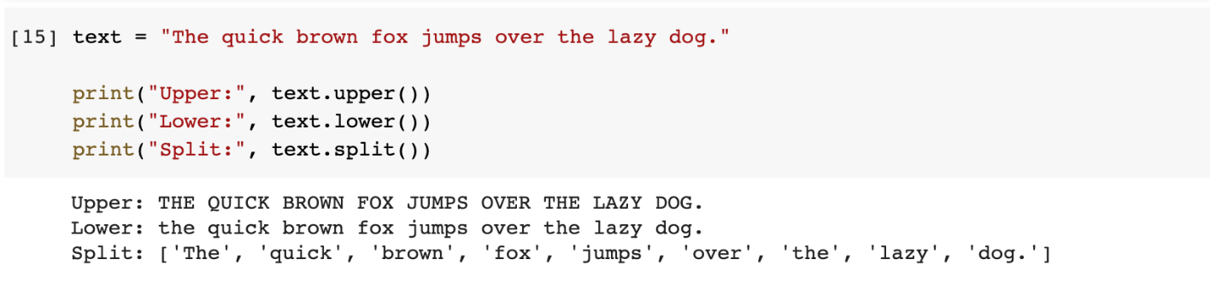
Python Strings
String methods
Full methods: https://www.w3schools.com/python/python_strings_methods.asp

Slide 27
Working with Numbers

Slide 28
Basic Operations

Slide 29
Built-in Functions
abs(num)
pow(num1,num2)

Slide 30
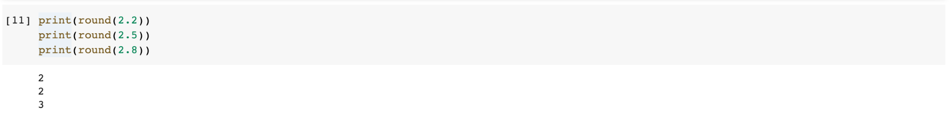
Built-in Functions
min(num1,num2) and max(num1,num2)
round(num)

Slide 31
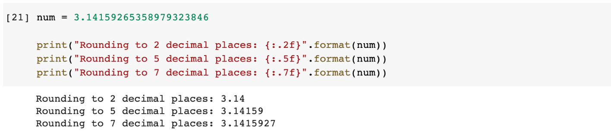
Displaying Decimal Places
Use format()

Slide 32
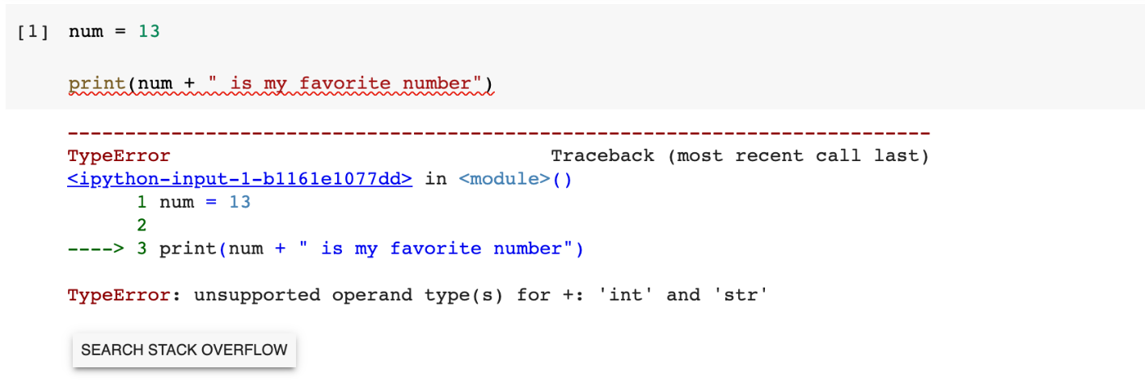
Oops, Error!
Can you fix this error?

Slide 33
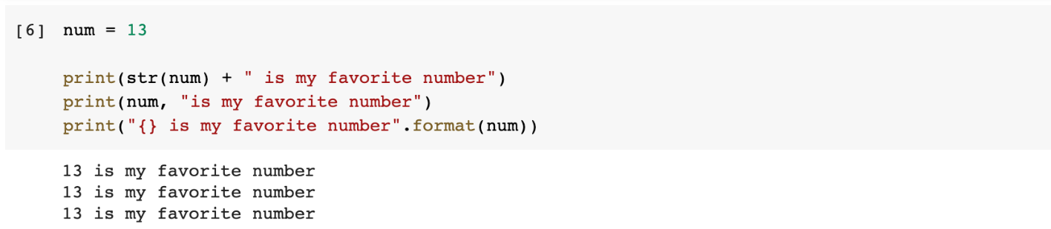
Oops, Error!
Answer:

Slide 34
Operators

Slide 35
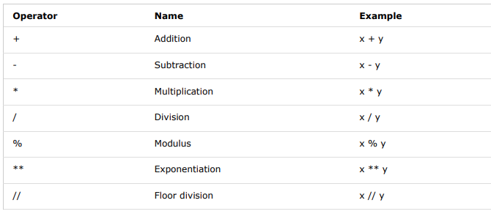
Arithmetic Operators

Slide 36
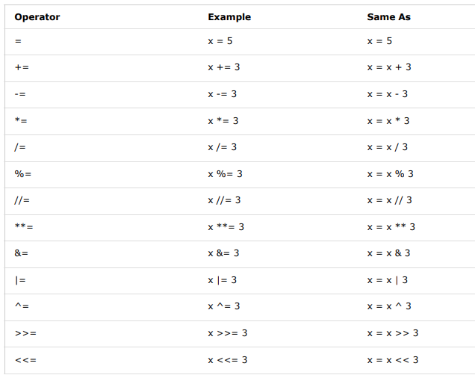
Assignment Operators

Slide 37
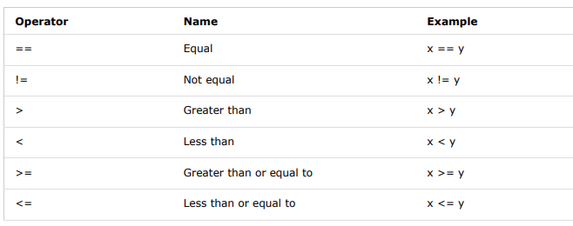
Comparison Operators

Slide 38
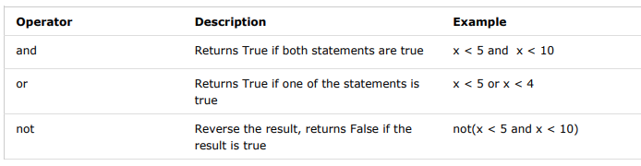
Logical Operators

Slide 39
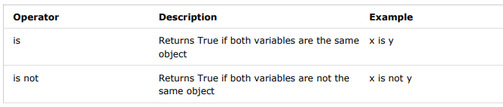
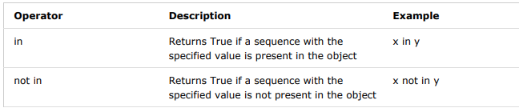
Identity Operators
Membership Operators

Slide 40
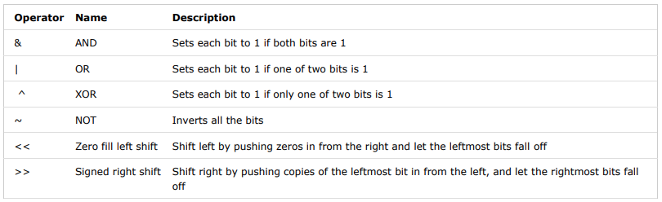
Bitwise Operators

Slide 41
Conditionals & Loops

Slide 42
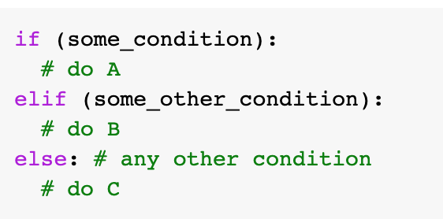
If Statement
Syntax:

Slide 43
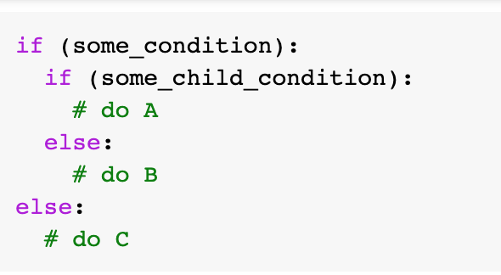
If Statement
Nested If

Slide 44
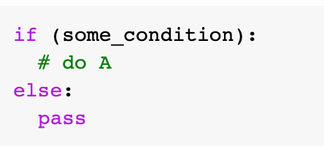
If Statement
Pass Statement
If statements cannot be empty, if you have no content to put in the statement, use pass instead.

Slide 45
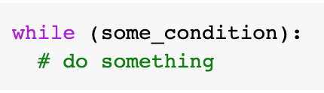
While Loops
Execute a set of statements as long as a condition is true.
Syntax:

Slide 46
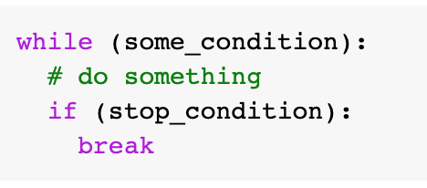
While Loops
Break Statement
Use to stop the loop.

Slide 47
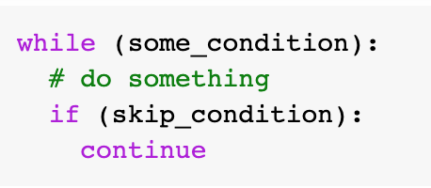
While Loops
Continue Statement
Use to stop current iteration and continue with the next.

Slide 48
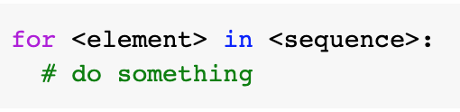
For Loops
Used to iterate over a sequence.
Syntax:

Slide 49
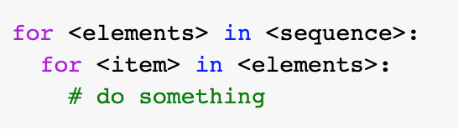
For Loops
Nested For Loops

Slide 50
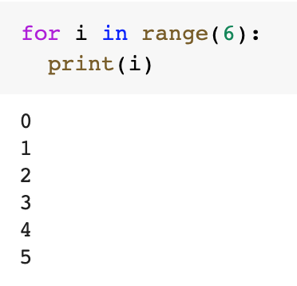
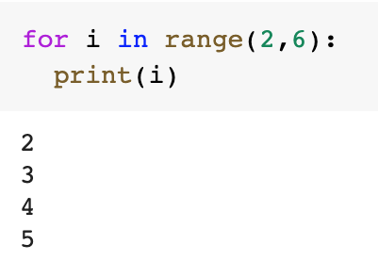
For Loops
Range

Slide 51
List, Tuple, & Dictionary

Slide 52
Python Lists
Ordered, indexed, changeable, allow duplicate values
First item index is [0], second item index is [1], and so forth
Can contain different data types

Slide 53
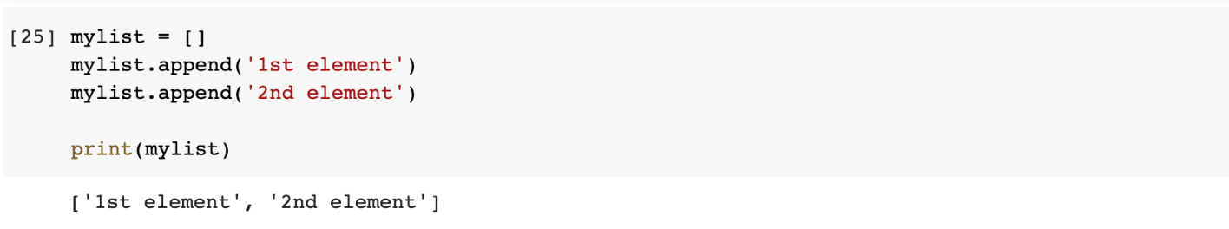
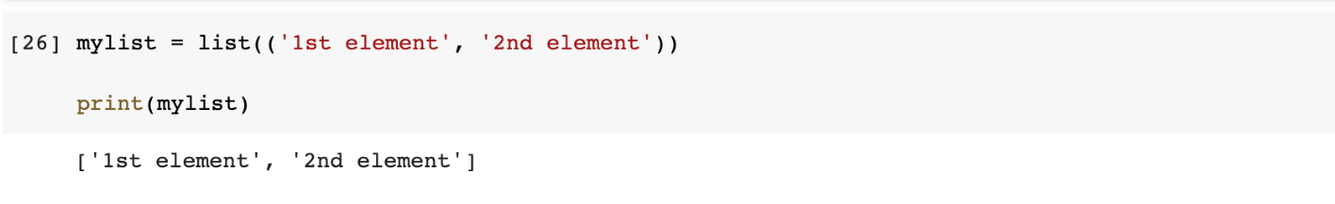
List Construction
append()
list()

Slide 54
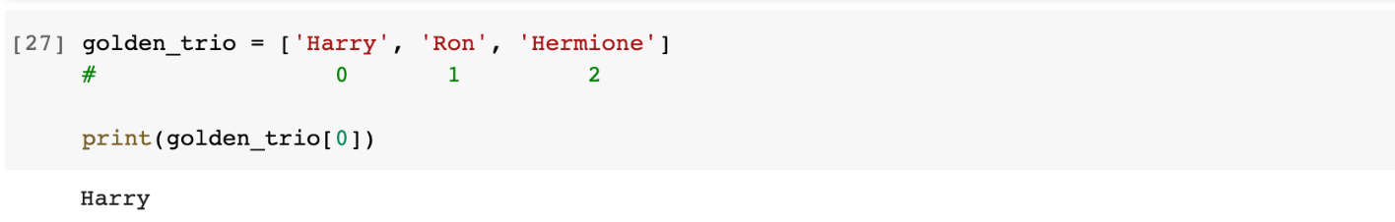
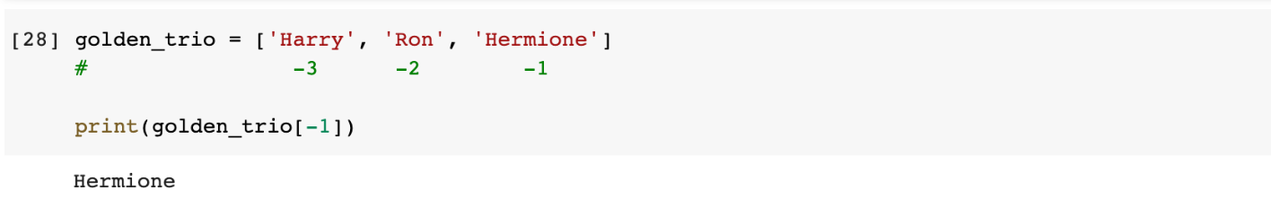
Accessing List Elements
Index
Negative index

Slide 55
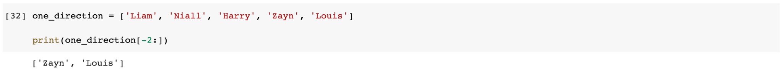
Accessing List Elements
Range
Negative range

Slide 56
Accessing List Elements
Range
Negative range

Slide 57
List Functions
list.sort(): Sorts the list in ascending/descending order.
list.append(item): Adds an item to the end of list.
list.insert(pos,item): Adds an element to a specified position.
listA.extend(listB): Adds elements of list B to end of list A.
list.remove(item): Removes the first item with the specified value.
list.pop(pos): Removes the element at the specified position.
list.count(item): Returns the number of elements with the specified value.
list.clear(): Removes all elements from list.

Slide 58
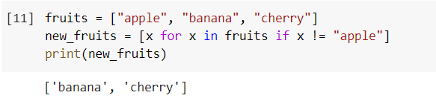
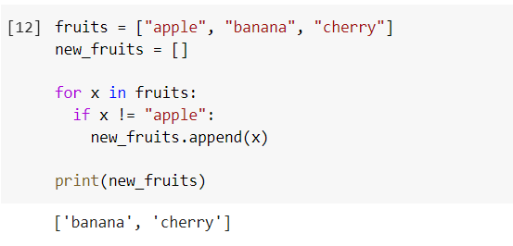
List Comprehension
Shorter syntax to create new list from existing list
Example

Slide 59
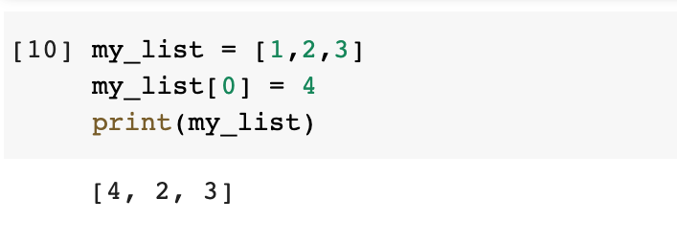
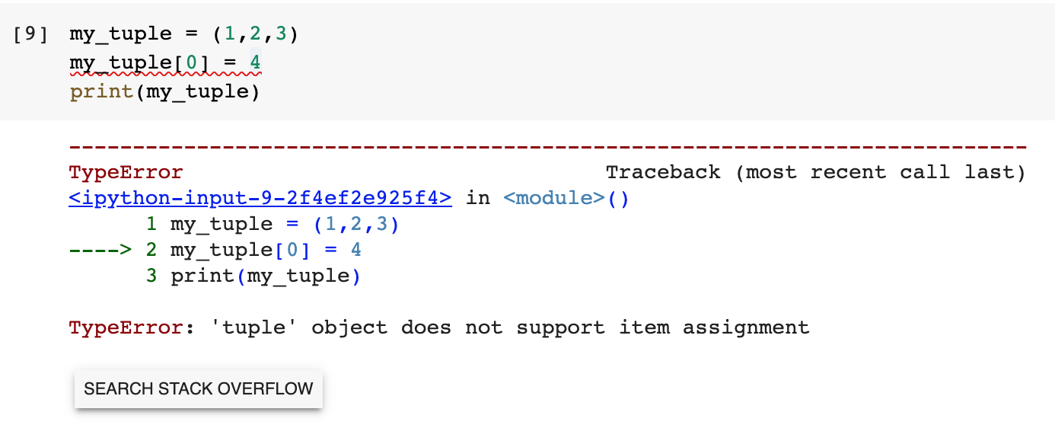
Python Tuples
Ordered, unchangeable, and allow duplicate values.
Basically the same as list, but elements cannot be changed.

Slide 60
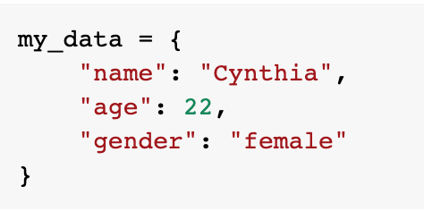
Python Dictionaries
Items are presented in key:value pairs, and can be referred to by using the key name.
Ordered, changeable, and does not allow duplicates.

Slide 61
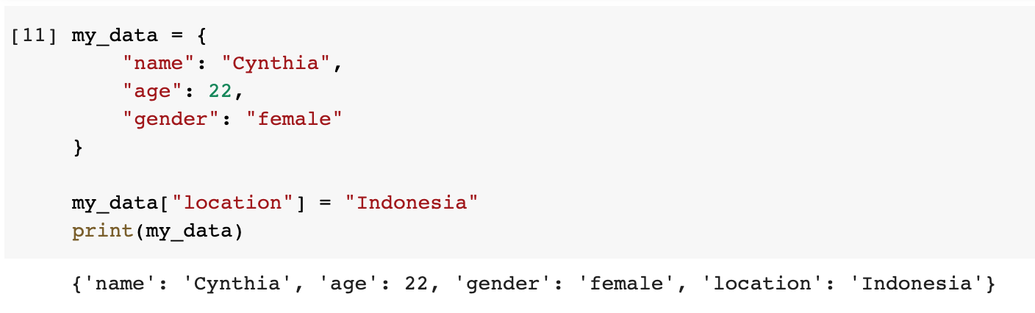
Constructing Dictionaries
Adding element

Slide 62
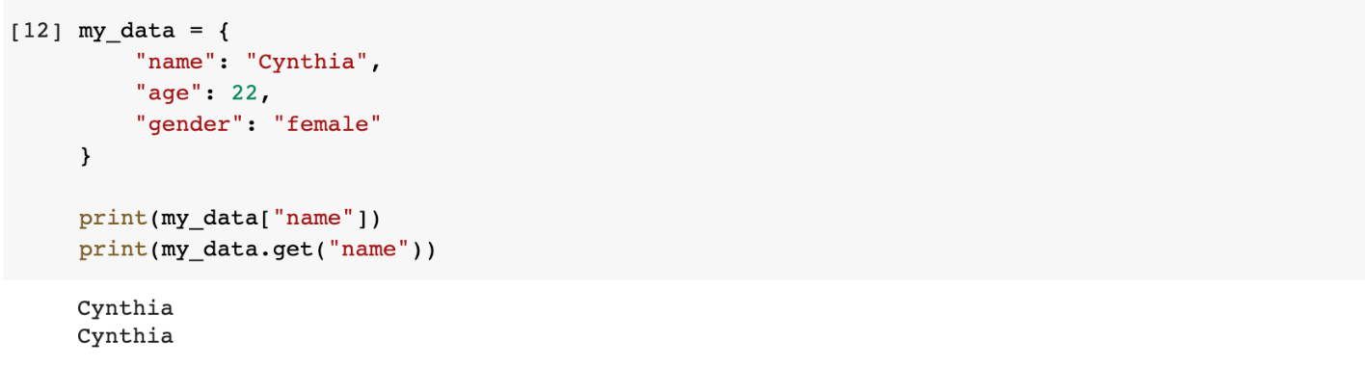
Accessing Items
Referring to key name
Square brackets []
dict.get()

Slide 63
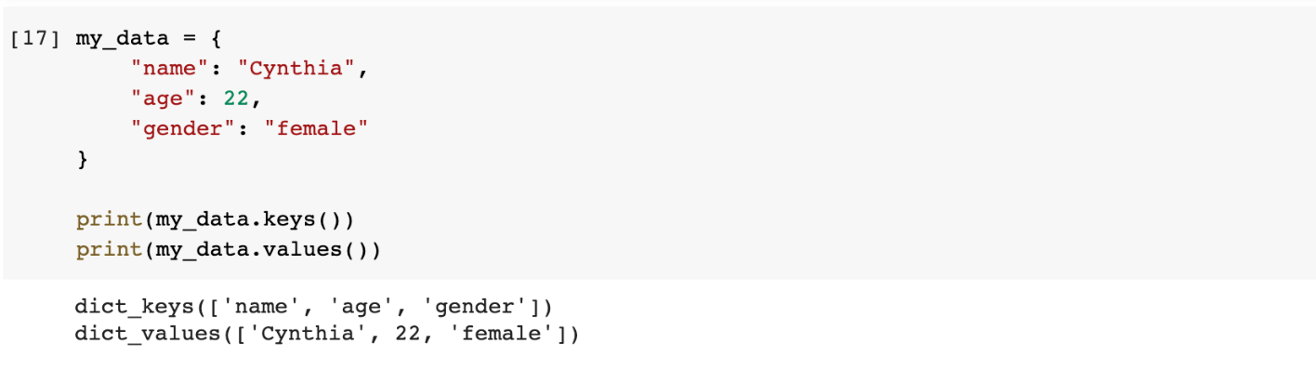
Accessing Items
Get keys and values of a dictionary

Slide 64
Accessing Items
Get keys and values of a dictionary

Slide 65
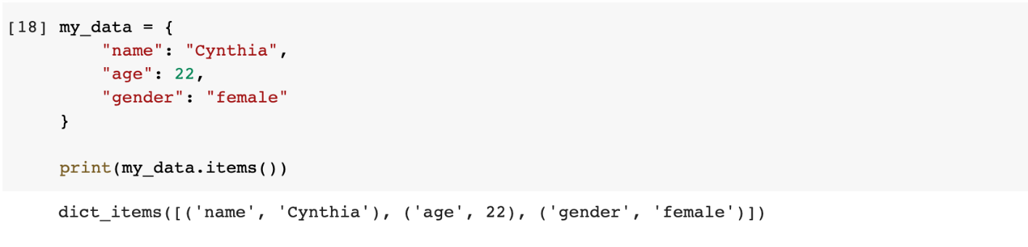
Accessing Items
Get items in key-value pairs of a dictionary

Slide 66
Accessing Items
Get items in key-value pairs of a dictionary

Slide 67
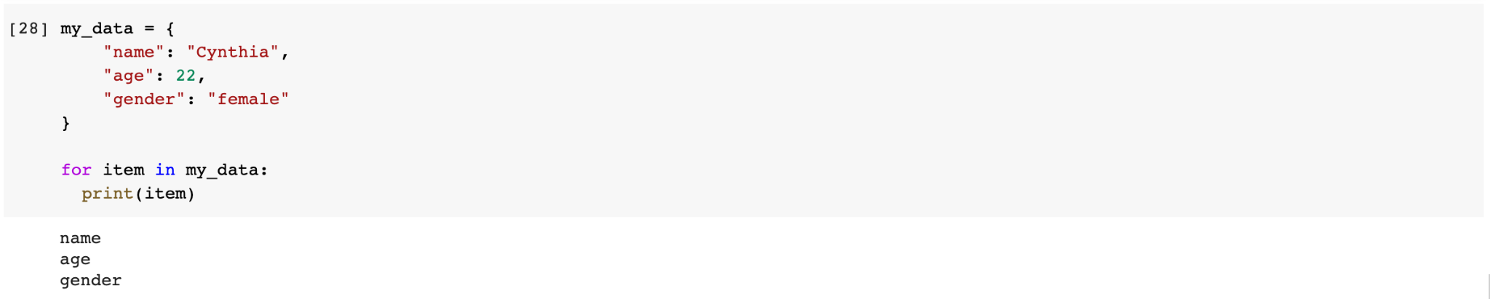
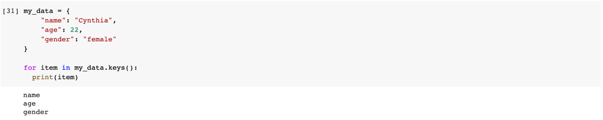
Loop Through a Dictionary
Return the keys

Slide 68
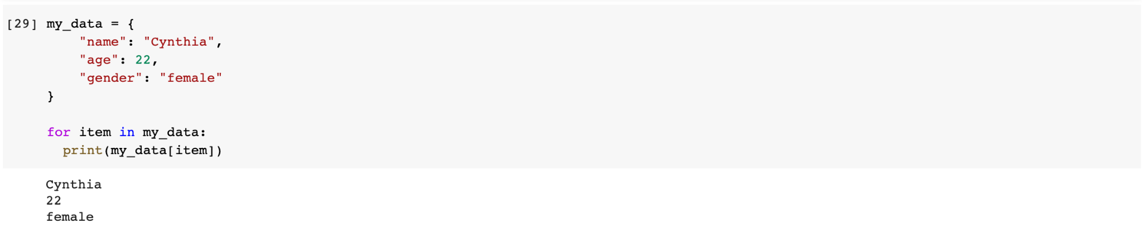
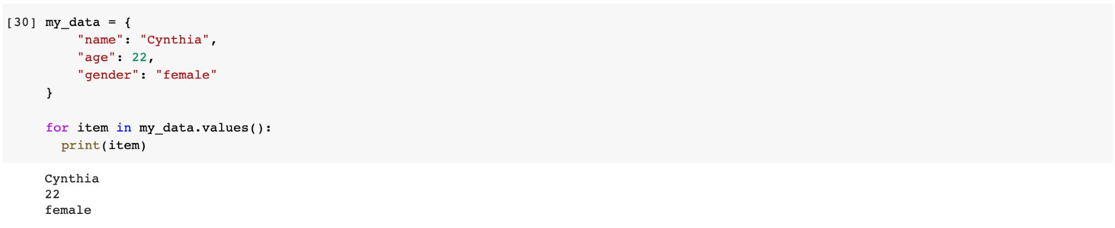
Loop Through a Dictionary
Return the values

Slide 69
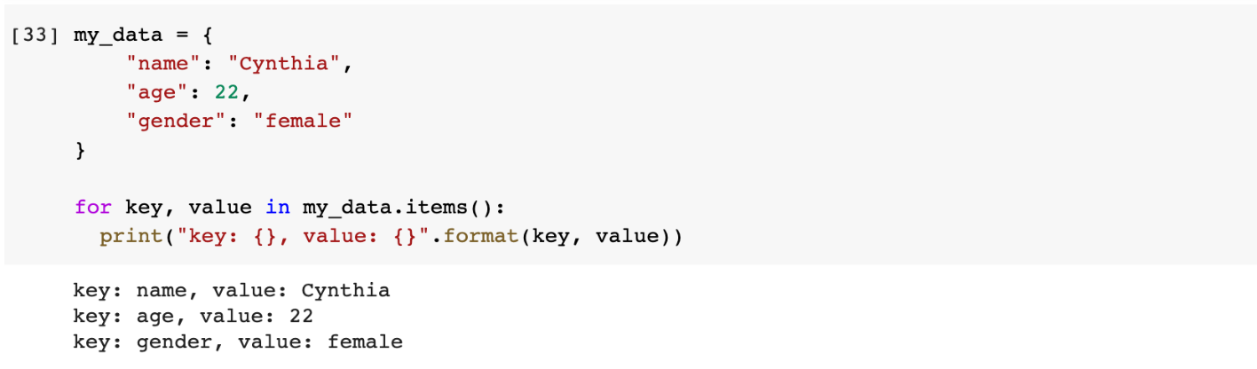
Loop Through a Dictionary
Return the keys and values

Slide 70
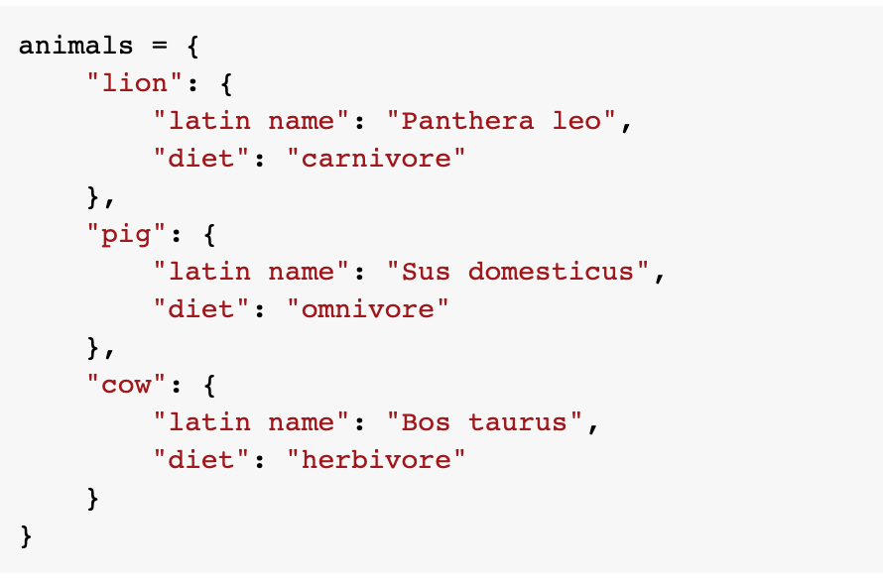
Nested Dictionary
Dictionary inside a dictionary

Slide 71
Nested Dictionary
Dictionary inside a dictionary

Slide 72
Function

Slide 73
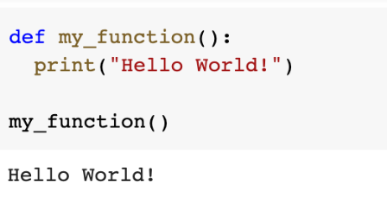
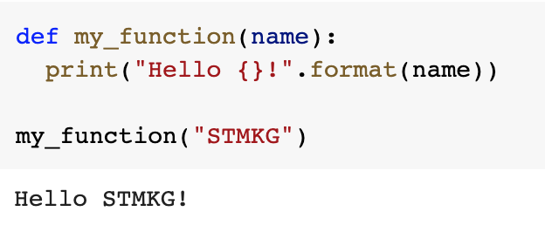

What is a Function?
A block of code that only runs when it is called.
Can pass data (parameters) as arguments to a function.
A function can return data as a result.
Examples:

Slide 74




Why Do We Use Functions?
Reduce duplication of code
Break down complex problems into simpler ones
Improve code readability
Reuse code

Slide 75

Function Arguments
Order matters, unless we use key-value as argument

Slide 76

Arbitrary Arguments
*args

Slide 77

Arbitrary Keyword Arguments
**kwargs

Slide 78

Default Parameter
Provides a default value if the function is called without passing an argument.

Slide 79
References
https://en.wikipedia.org/wiki/Python_(programming_language)
https://www.geeksforgeeks.org/python-language-advantages-applications/
https://www.guru99.com/python-2-vs-python-3.html
https://www.w3schools.com/python
https://www.youtube.com/watch?v=rfscVS0vtbw

Slide 80




Thank You!

